Slide 1
NETW211 Course Project Module 5 Cloud Storage Edward Alvarado March 2022

Slide 2
Rubric
Activity | Requirement(s) | Points
Uploading and Accessing a File | Screenshot | 15
Creating Blob Snapshots | Question, Screenshot | 30
Enabling Blob Versioning | Screenshot | 15

Slide 3
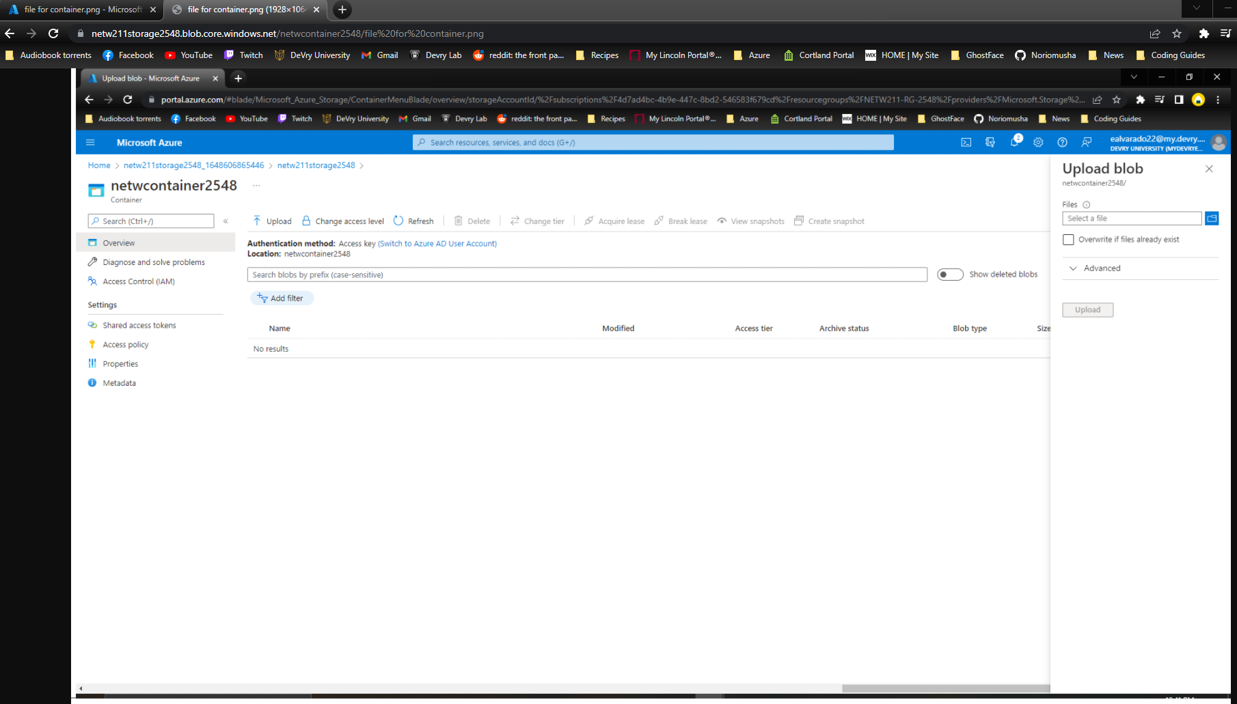
Uploading and Accessing a File
This screenshot should show the browser window with the image uploaded from your local computer and the URL on top of the window.

Slide 4
Question
What does the access tier setting do? What are the Azure blob storage access tiers?
Answer here:
When your data is stored in an online access tier (either Hot or Cool), users can access it immediately. The Hot tier is the best choice for data that is in active use, while the Cool tier is ideal for data that is accessed less frequently, but that still must be available for reading and writing.
Hot tier - An online tier optimized for storing data that is accessed or modified frequently. The Hot tier has the highest storage costs, but the lowest access costs.
Cool tier - An online tier optimized for storing data that is infrequently accessed or modified. Data in the Cool tier should be stored for a minimum of 30 days. The Cool tier has lower storage costs and higher access costs compared to the Hot tier.
Archive tier - An offline tier optimized for storing data that is rarely accessed, and that has flexible latency requirements, on the order of hours. Data in the Archive tier should be stored for a minimum of 180 days.
References:
1. https://docs.microsoft.com/en-us/azure/storage/blobs/access-tiers-overview
2.

Slide 5
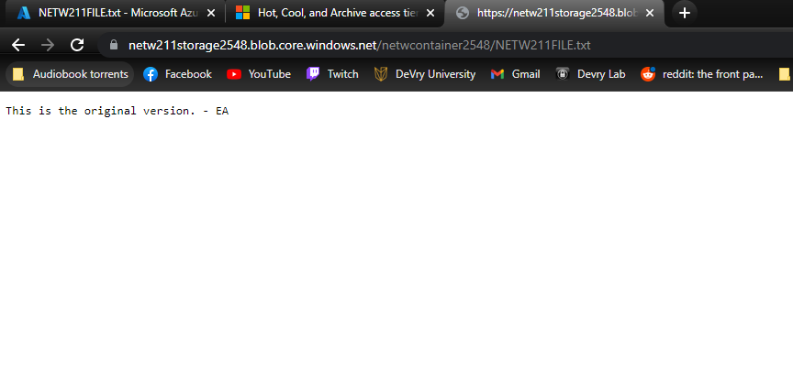
Creating Blob Snapshots
This screenshot should show the browser window with the “This is the original version. –Your Initials” message and the URL on top of the window

Slide 6
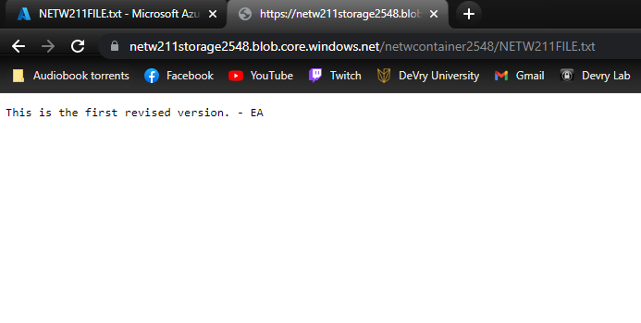
Enabling Blob Versioning
This screenshot should show the browser window with the “This is the first revised version. –Your Initials” message and the URL on top of the window.

